Slide 1
NEO4J CYPHER TUTORIAL WITH PYTHON
Load JSON Data Using Neo4j Cypher & Apoc
Tutorial 81

Slide 2
Sample json data
{name: "DS101", subjects: ["coding", "data_structure", "algorithm"], duration: 1}

Slide 3
Use case
Load json data from file using apoc procedure

Slide 4
Pre-requisites
apoc.import.file.enabled=true
apoc.import.file.use_neo4j_config=false

Slide 5
code
call apoc.load.json("file:///users/roni/data/sample.json")
yield value
How to read json file

Slide 6
code
call apoc.load.json("file:///users/roni/data/sample.json")
yield value
with size(value.subjects) as subject_count,value
return subject_count,value.name as name,value.subjects as subjects
How to read json file full code

Slide 7
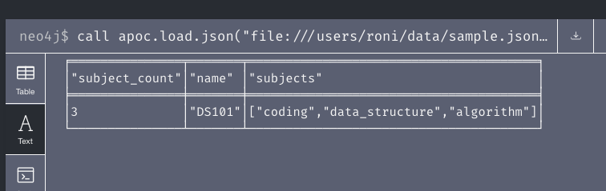
output
How to read json file full code

Slide 8
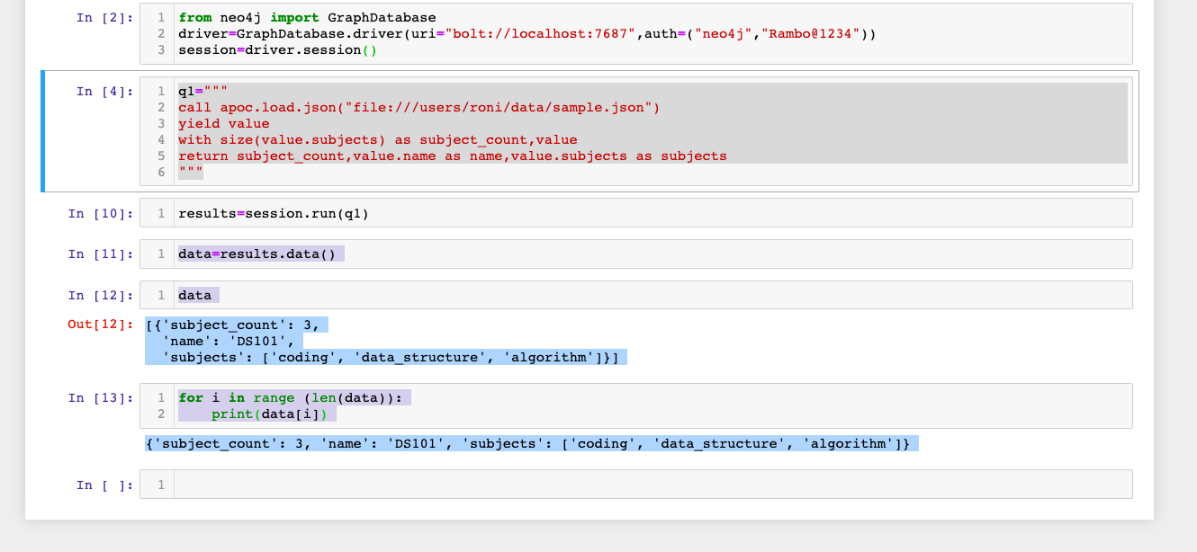
Python code
How to read json file full code

